Slide 1
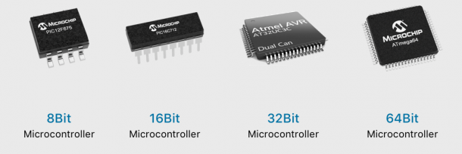
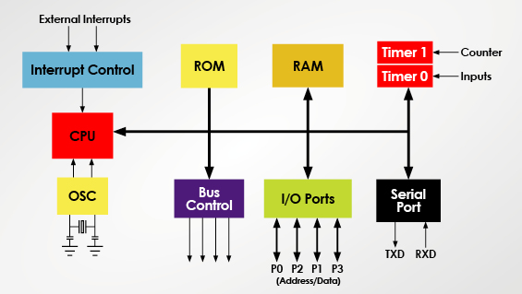
Microprocessor – Microcontroller
Introduction
LÊ TRỌNG NHÂN
trongnhanle@hcmut.edu.vn
trongnhanle85@gmail.com

Slide 2
Basic Concepts in Interrupts
An interrupt is a communication process set up in a microcontroller (and also in a microprocessor) in which:
  An internal or external device requests the MPU to stop the processing
  The MPU acknowledges the request
  Goes back to the processing when the request is served

Slide 3
MPU Response to Interrupts
When the interrupt process is enabled, the MPU, during in the execution, checks the interrupt flag just before the end of each instruction
If the interrupt request is requested, the MPU:
  Completes the execution of the instruction
  Save the address of the program counter (PC) on the stack
  Stops the execution

Slide 4
MPU Response to Interrupts
The set of instructions written to meet the request is called an interrupt service routine (ISR)
Once the request is accomplished, the MPU should find its way back to the instruction, next memory location where it was interrupted:
  Accomplished by a specific return instruction (RETI)

Slide 5
Interrupt Vectors
Define memory location where a specific memory location is assigned to the interrupt request
Define vector location where specific memory locations assign to the store the vector addresses of the ISRs

Slide 6
Interrupt Service Routine (ISR)
A group of instructions that accomplishes the task requested by the interrupting source
Similar to a subroutine except that the ISR must be terminated in a RETURN instruction specially designed for interrupts (e.g. RETI):
  The return instruction, when executed, find the return address on the stack and redirects the program execution where the program was interrupted
  Some return instructions are design to retrieve the contents of MPU registers if saved as a part of the interrupts

Slide 7
Reset Interrupt
Reset is an external signal that enables the MPU to begin execution or interrupts the processor if the processor is executing instructions.
There are at least two types of resets:
  Power on reset and manual reset
When the reset signal is activated, it establishes the initial conditions of the processor and directs the processor to a specific starting memory location

Slide 8
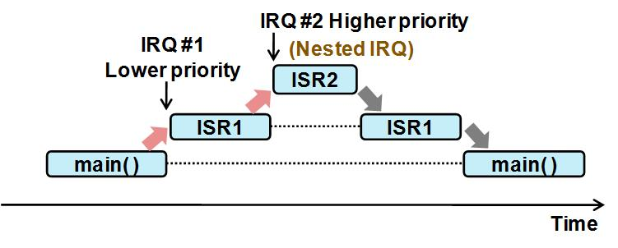
Interrupt Priority

Slide 9
Types of Interrupts
Hardware interrupts:
  Maskable: Can be masked or disabled
  Non-maskable: Cannot be disabled
  External and Internal interrupts
Software interrupts: generally used when the situation requires stop processing and start all over:
  Divide by zero or stack overflow
  Generally, MPUs do not include software interrupts

Slide 10
Timer Interrupt

